Slide 1
Wave Behavior Notes

Slide 2
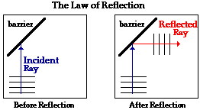
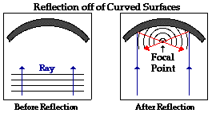
Reflection
Reflection involves a change in direction of waves when they bounce off a barrier.

Slide 3
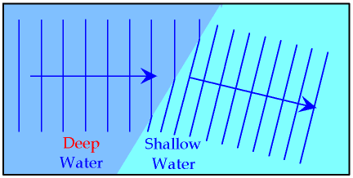
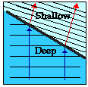
Refraction
Refraction of waves involves a change in the direction of waves as they pass from one medium to another.

Slide 4
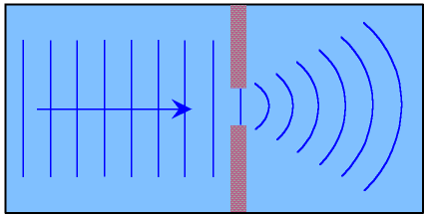
Diffraction
Diffraction involves a change in direction of waves as they pass through an opening or around a barrier in their path.

Slide 5

Interference
Wave interference is the phenomenon that occurs when two waves meet while traveling along the same medium.

Slide 6

Constructive interference
Constructive interference is a type of interference that occurs at any location along the medium where the two interfering waves have a displacement in the same direction.

Slide 7
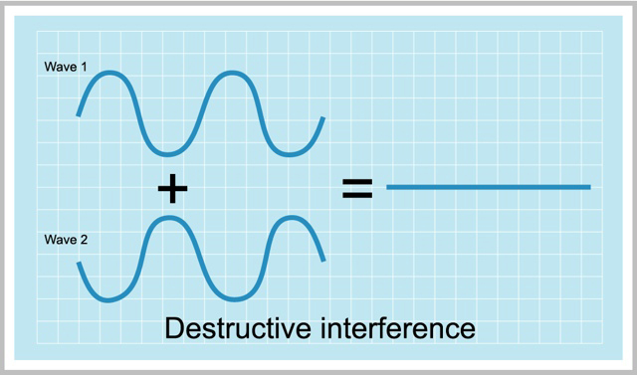
Destructive interference
Destructive interference is a type of interference that occurs at any location along the medium where the two interfering waves have a displacement in the opposite direction.

Slide 8

After Interference
The meeting of two waves along a medium does not alter the individual waves or even deviate them from their path.
When the two waves will meet, they produce a net resulting shape of the medium, and then continue on doing what they were doing before the interference.

Slide 10
Principle of Superposition
When two waves interfere, the resulting displacement of the medium at any location is the algebraic sum of the displacements of the individual waves at that same location.

Slide 11
Traveling Waves vs. Standing Waves
Traveling waves are observed when a wave is not confined to a given space along the medium.
When the proper frequency is used, the interference of the incident wave and the reflected wave occur in such a manner that there are specific points along the medium that appear to be standing still. Because the observed wave pattern is characterized by points that appear to be standing still, the pattern is often called a standing wave pattern.

Slide 12
Standing Wave
The waves are interfering in such a manner that there are points of no displacement produced at the same positions along the medium. These points along the medium are known as nodes.
There are also points along the medium that vibrate back and forth between points of large positive displacement and points of large negative displacement. These points are known as antinodes.

